Slide 1
Basics of Virtualization
https://cloudzy.com/blog/qemu-vs-kvm/

Slide 2
What Is a Hypervisor?
A hypervisor is a technical process that creates a divider between the host’s hardware components and a computer’s operating system.
Type-1 hypervisor, mostly known as a bare-metal hypervisor, is in charge of executing commands on the host’s hardware.
Type-2 hypervisor, known as a hosted hypervisor, creates virtual environments on multiple devices while running on a conventional operating system.

Slide 3
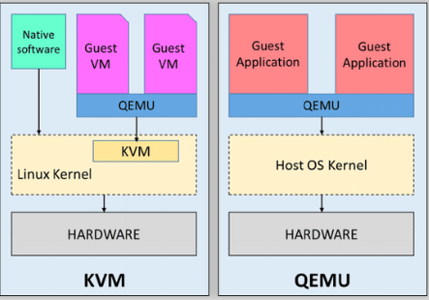
QEMU Vs KVM
KVM is a type-1 hypervisor, and QEMU is a type-2 hypervisor

Slide 4
What is QEMU?
QEMU is short for Quick Emulator and is open-source virtualization software that can emulate CPUs and hardware.
QEMU can run operating systems and applications that are not compatible with your host operating system hardware platform.
A hardware virtualization tool that can enhance your virtual machine performance.
QEMU runs on both Windows and Linux
KVM runs only on Linux-based host OS.

Slide 5
What is KVM?
KVM is short for Kernel-based Virtual Machine that turns your Linux system into a type-1 (bare-metal) hypervisor.
KVM allows you to create isolated virtual environments, and since it’s built into Linux operating system code, it has all the features that come with the Linux kernel.

Slide 6
Why QEMU along KVM?
KVM acts as an outer guard that monitors QEMU executions to make sure the performance level is at its highest.
But how does KVM enhance performance, you may ask?
  Imagine you partition the CPU to make a virtual CPU for your virtual environment. By providing hardware-assisted virtualization, KVM allows mapping between the vCPU and the actual CPU. This way, all the tasks that are delegated to vCPU get executed on one tiny slice of the physical CPU.
KVM runs as a Linux kernel module. That’s how it can offer hardware-assisted virtualization and not sacrifice performance.

Slide 7
KVM vs QEMU; which is faster?
KVM is faster, but this is not the only feature you should consider.
The best virtualization solution is fast, secure, reliable, scalable, and cost-effective.
If you are looking for the perfect virtualization package for your VM, use them both

Slide 8
Is QEMU required for KVM?
KVM is a Linux-based full virtualization solution, so you can definitely use it without QEMU.
However, if you are looking for a powerful type-1 hypervisor that provides better performance and stability, using KVM and QEMU together is your best bet.

Slide 9
Can QEMU work without KVM?
Yes.
KVM and QEMU are entirely independent of each other.
If you use KVM to run QEMU, you won’t have to worry about execution failures on the host CPU.

Slide 10
